Slide 1
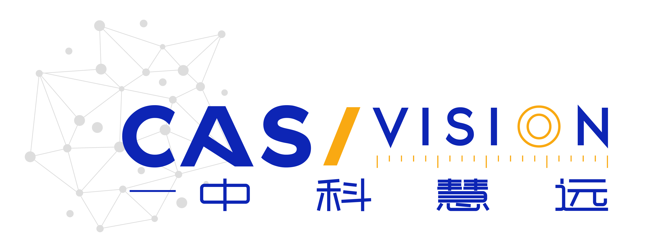

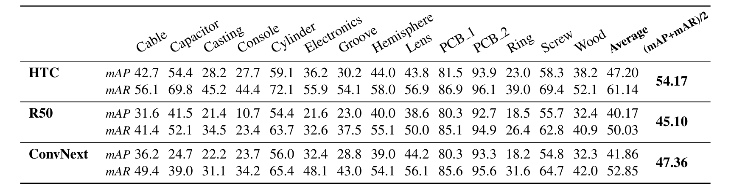
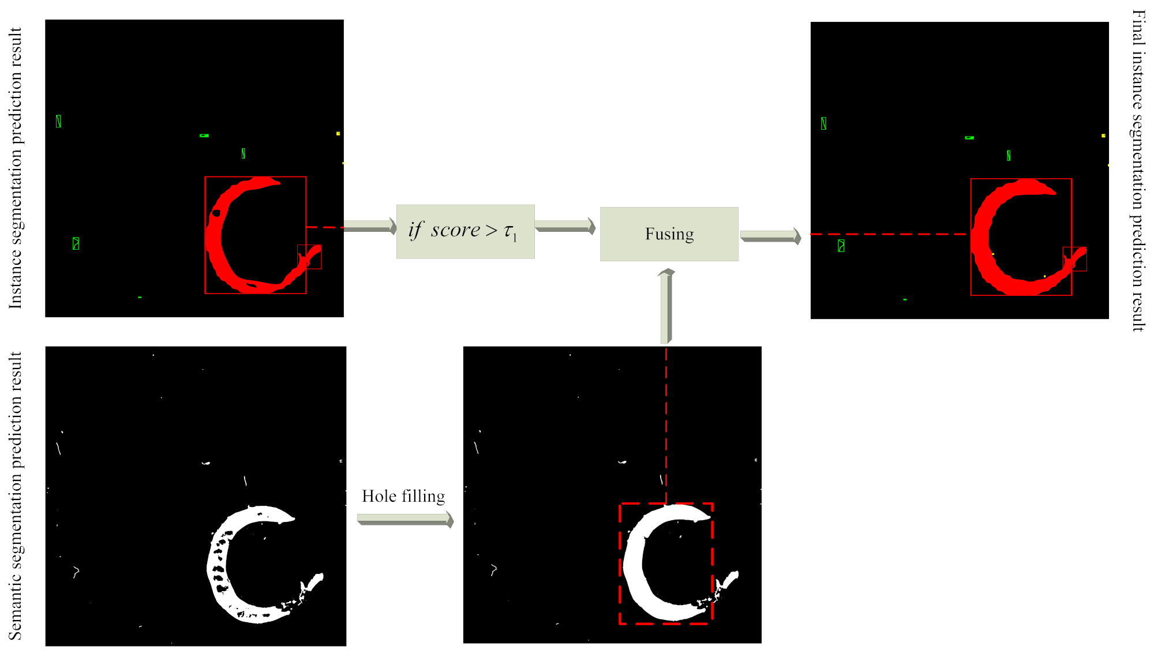
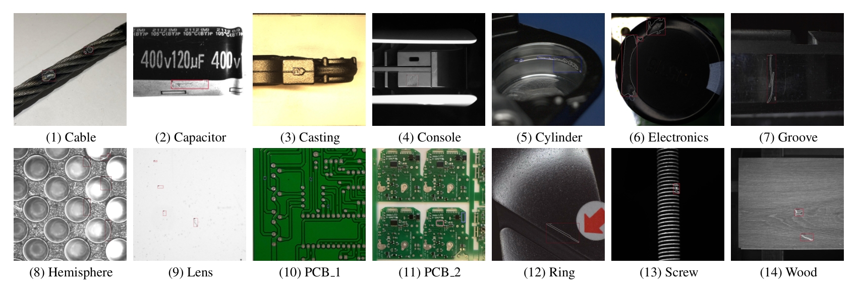
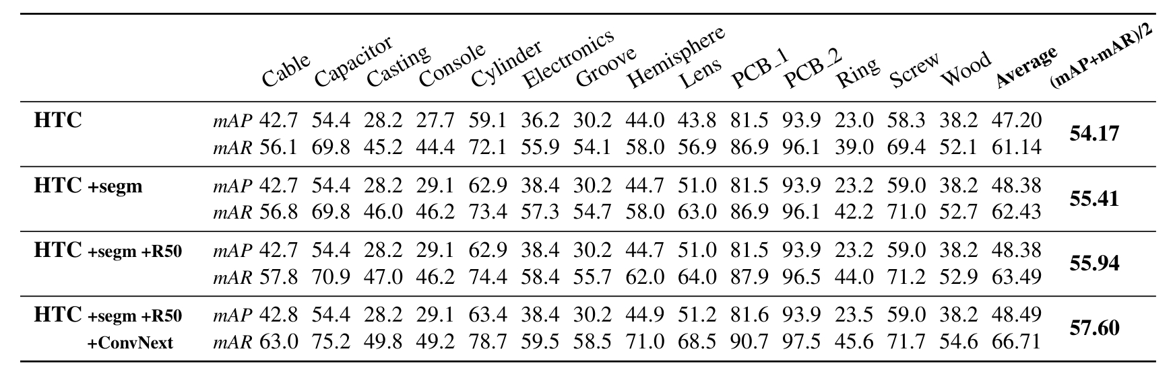

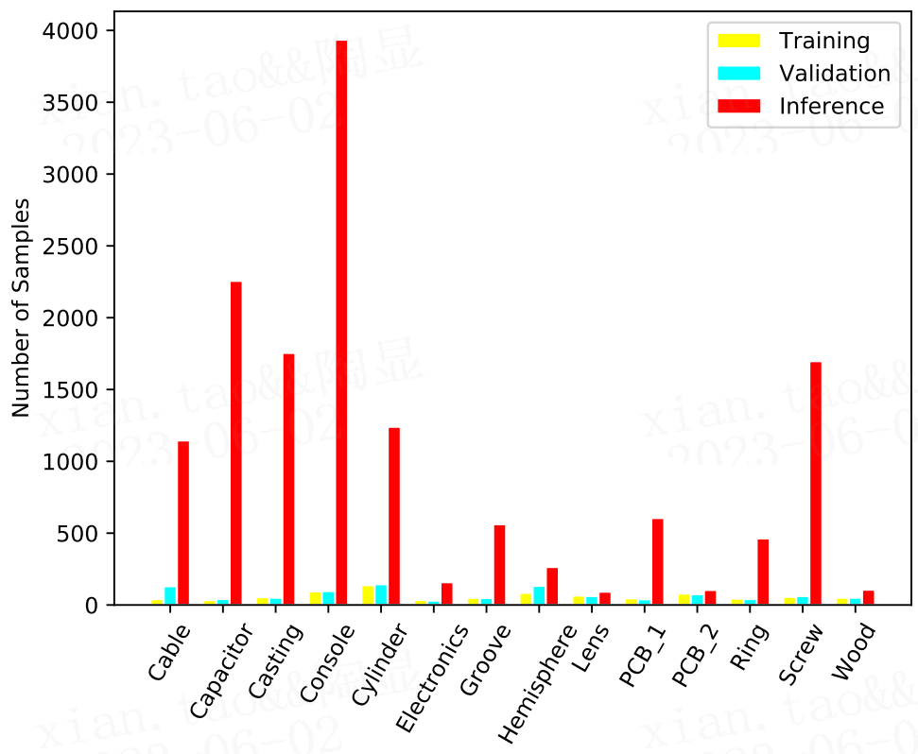
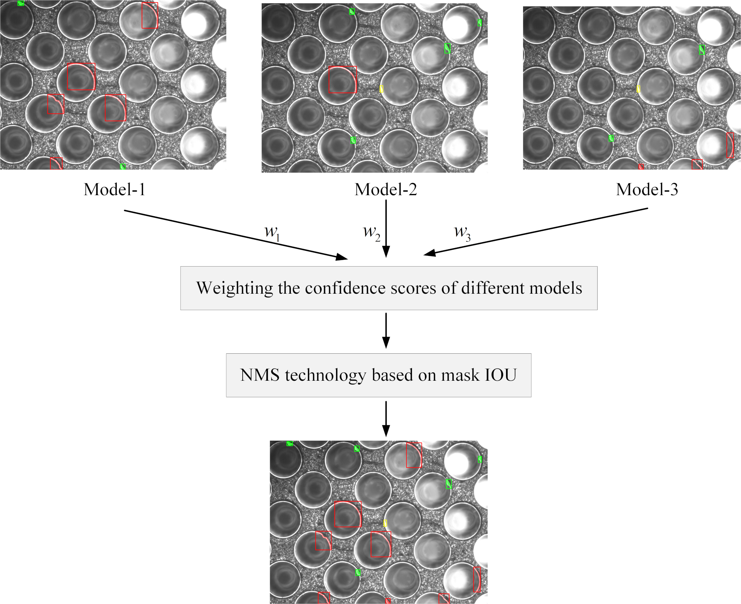
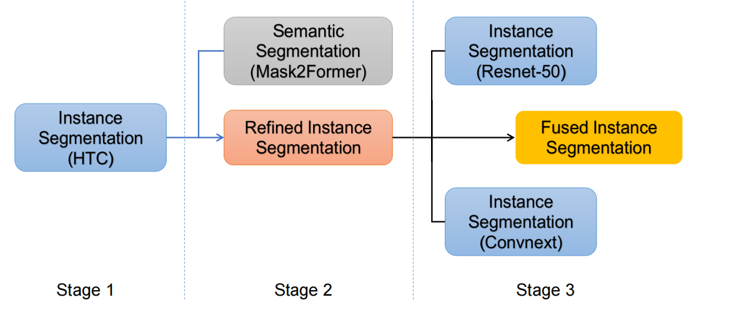

Aoi-overfitting-team Solution for VISION Challenge Competition Track 1 (2nd Place)
Xian Tao, Zhen Qu, Hengliang Luo, Jianwen Han, Yonghao He, Danfeng Liu, Chengkan Lv, Fei Shen, Zhengtao Zhang
CASI Vision Technology Co., Ltd., Luoyang, China && Institute of Automation, Chinese Academy of Sciences
Vision-based InduStrial InspectiON
VISION 23 Challenge Track 1 - Data Efficient Defect Detection.
There are14 industrial inspection datasets in this challenge.
Training samples are extremely scarce.
The image size and proportion of defects vary for each dataset.
Solution Pipeline
Key Points
Incorporating semantic segmentation(Mask2Former) into instance segmentation
Fusion of multiple instance segmentations
Result
Results of different instance segmentation models
Results of fusing different models
Increase precision
DataSet | image size [width, height]
cable | [910, 466], [904, 566],[990, 406], [726, 287], [262, 192],[908, 634],[1016, 484], [974, 454], [992, 518], [962, 692], [934, 722], [976, 470], [1010, 468], [996, 498], [1174, 822], [992, 408], [934, 502], [1528, 1146], [2624, 2624], [876, 592], [1026, 566], [1920, 1080], [632, 480]
Electronics | [413, 212], [528, 531], [961, 1303], [598, 563], [1207, 1268], [217, 664], [1421, 1292], [419, 180], [1444, 1439], [483, 397], [2179, 1288], [1328, 1253], [469, 480], [1323, 1122], [1293, 1338], [1293, 1314], [1233, 1384], [1219, 1179], [1037, 1308], [2153, 1398], [1298, 1286], [621, 589], [1374, 1298], [1268, 1227]
Lens | [3534, 3542], [3520, 3499], [3519, 3523], [3587, 3581],[3545, 3523], [3556, 3557], [3509, 3507], [3528, 3531], [3511, 3533], [3587, 3609], [3522, 3505], [3590, 3586], [3569, 3574], [3499, 3494], [3618, 3617], [3576, 3571], [3561, 3551],[3609, 3620], [2448, 2048], [512, 512]
PCB_1 | [2775, 2159], [3056, 2464], [2529, 2530], [2868, 2316], [3034, 1586], [2282, 2248], [2544, 2156], [2904, 1921], [2240, 2016]
Console | [3840, 2748], [1920, 1280]
Cylinder | [1600, 1200]，[1590, 1192]
Summary
We participated in the VISION 23 Challenge and obtained the second place.
Our multi-stage solution consists of three main components:
Utilizing CbSwin-HTC as the base model for instance segmentation.
Refining the instance segmentation process by implementing semantic segmentation (Mask2Former).
Integrating multiple instance segmentations to optimize results.
Code has been released publicly.
model-1:
CbSwin-HTC
model-2:
Cascade Mask rcnn-ResNet50
model-3:
Cascade Mask rcnn-ConvNext
Increase recall
https://github.com/love6tao/Aoi-overfitting-team

